Slide 1




PROBLEM SOLVING PROCESS
Class IX
lab 5

Slide 2
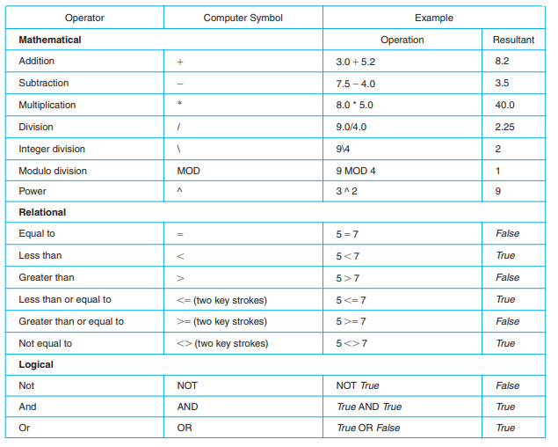
Operator and Their Symbols

Slide 3
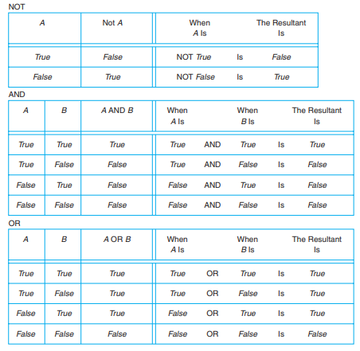
Logical Operators

Slide 4
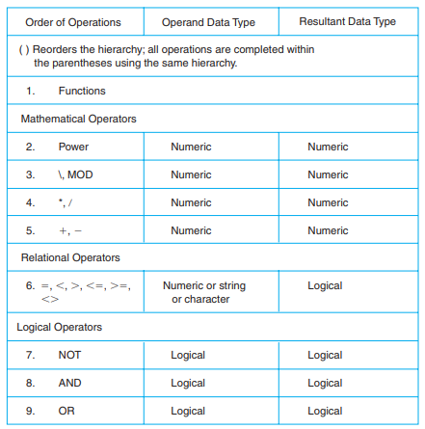
Hierarchy of Operations

Slide 5
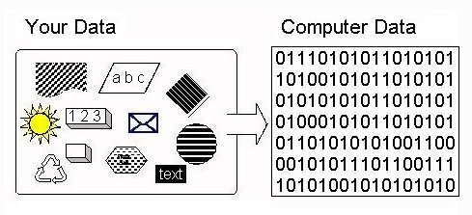
How the Computer Stores Data

Slide 6



